Slide 1
The Brazilian experience in international data dissemination – Países@
Ian M. Nunes – ian.nunes@ibge.gov.br
Date: 06/06/2013

Slide 2
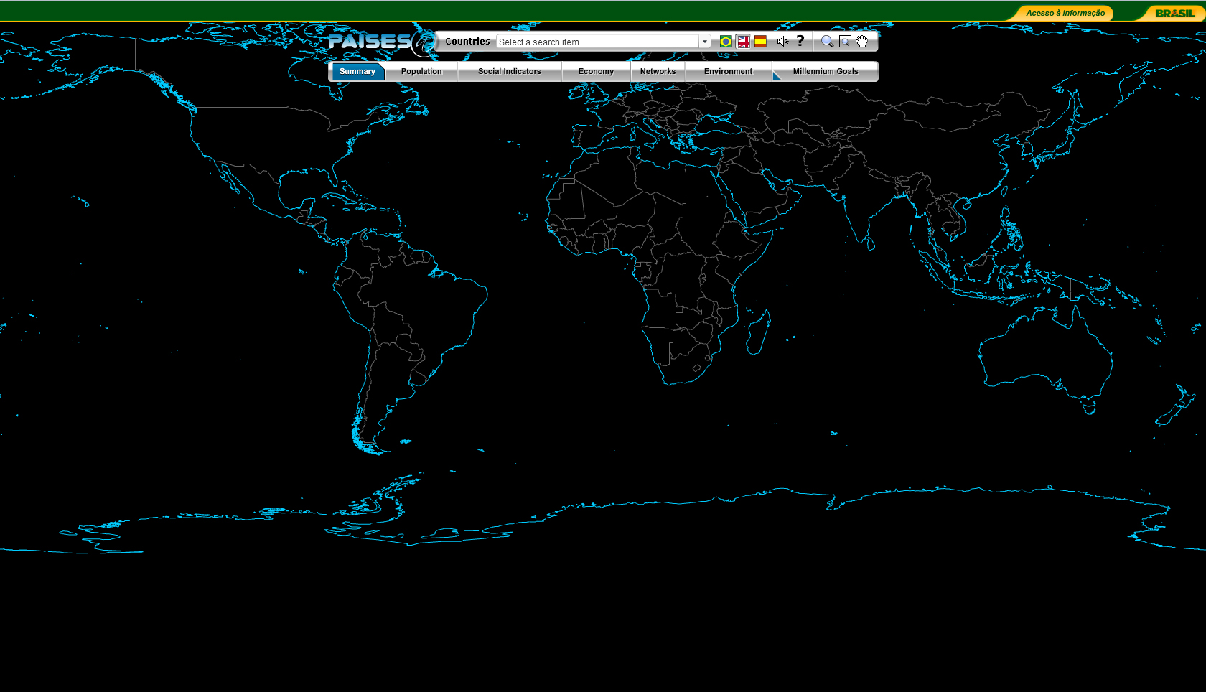
information on 196 countries according to 7 major topics (summary, population, social indicators, economy, networks, environment and millennium goals).

Slide 3
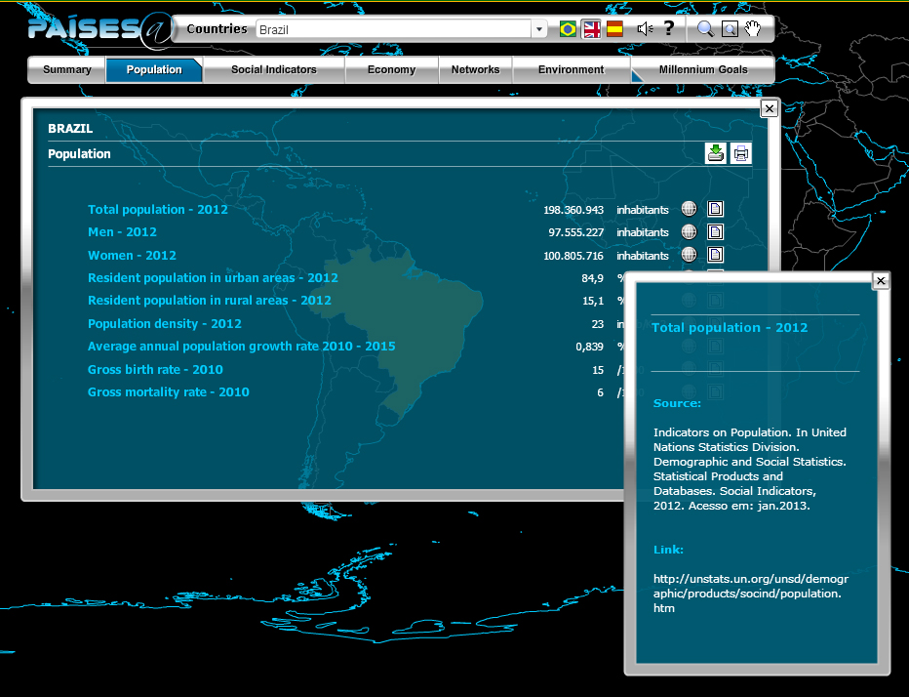
more than 70 variables, mainly from the United Nations Organization.

Slide 4
main sources used:
United Nations Statistical Division
Human Development Report (HDR)
World Health Organization (WHO)
Food and Agriculture Organization of the UN (FAO)
United Nations Children’s Fund (UNICEF)
United Nations Environment Programme
International Telecommunication Union (ITU)
World Development Indicators (The World Bank)

Slide 5
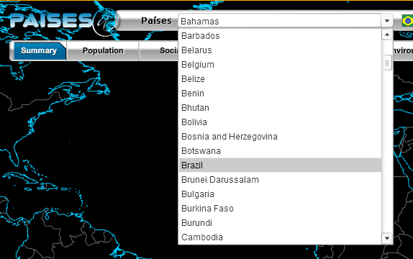
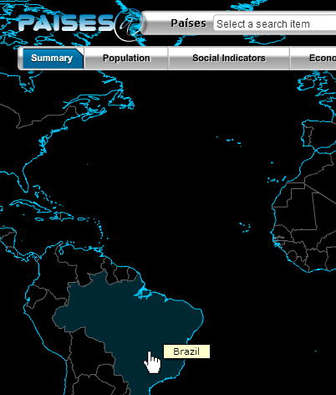
the countries are selected through the menu or directly on the planisphere.

Slide 6
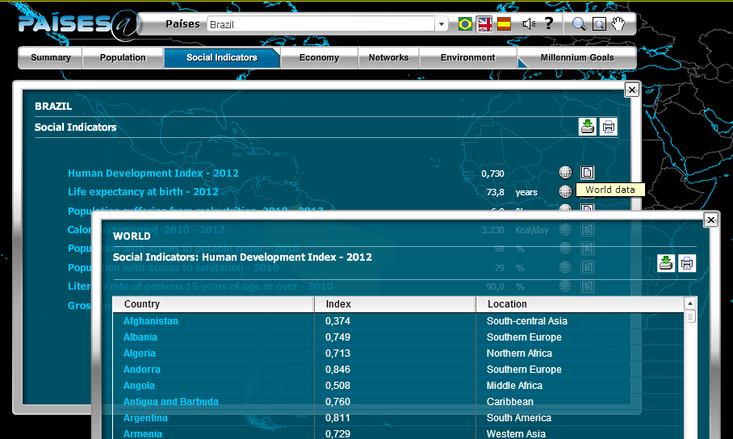
data of countries are compared and the information displayed can be exported as CVS files.

Slide 7
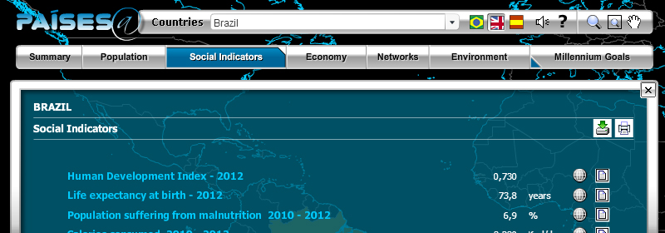
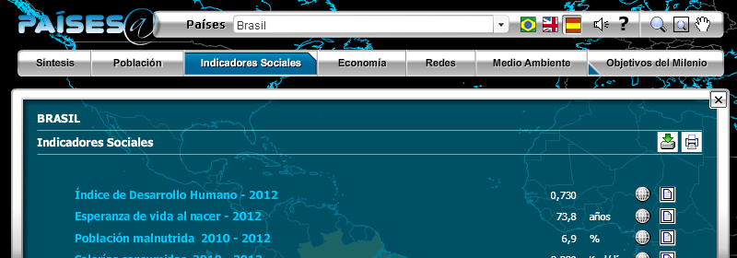
information is available in English and Spanish, besides Portuguese.

Slide 8
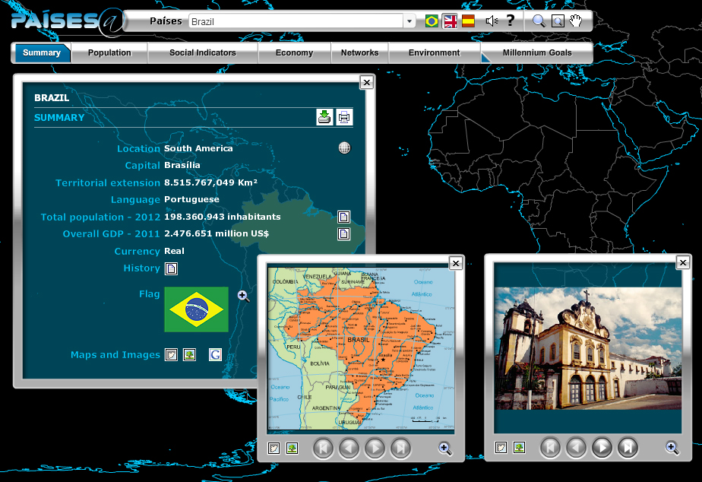
together with statistical data, the channel presents additional information on the countries: their history and flag, a simplified map, a link to Google Maps and a selection of photographs.

Slide 9
Statistics of access to Países@
Number of users up 197% in 4 years
2008
690,179 users
2012
2,051,727 users

Slide 10
Statistics of access to Países@
Users of Spanish and English together almost double those of Portuguese in 2012

Slide 11
www.ibge.gov.br
ian.nunes@ibge.gov.br

